Slide 1
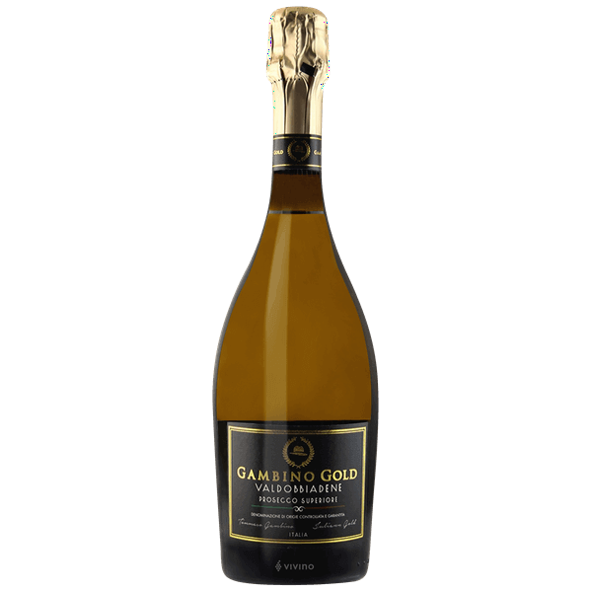
Gambino Gold Valdobbiandene Prosecco Superiore DOCG
Grape Varietal – 100% Glera
Region – Italy, Veneto, Conegliano-Valdobbiandene
Vintage – Nonvintage
Aroma – Green apples, Peach, Flowers
Taste – Pear, ginger, apples,
Finish – Creamy and fresh
Price on menu – $16 BTG / $90 BTL
Pairings – Shellfish, Salads, Seafood
Additional info – Grapes all hand harvested in specific region for DOCG status.

Slide 2
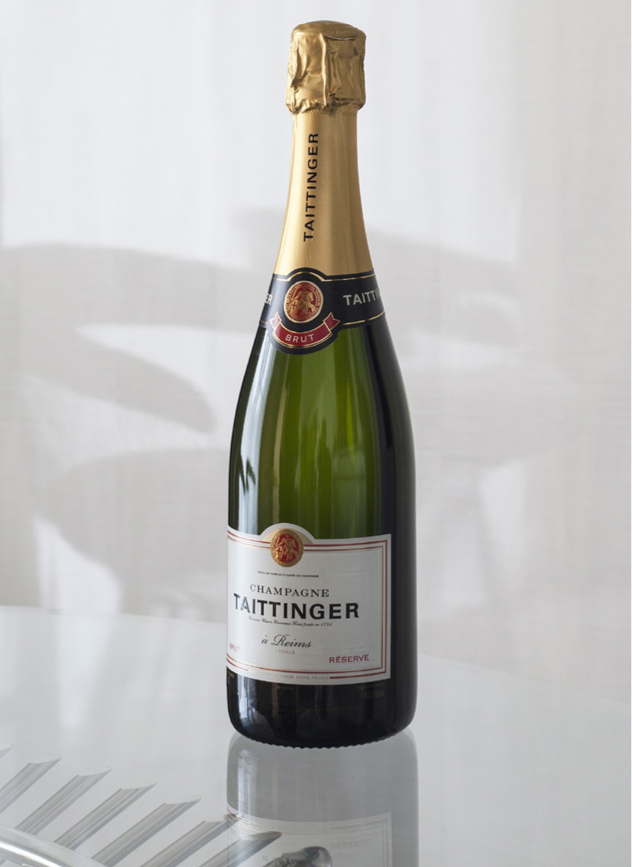
Champagne Taittinger Brut, La Francaise
Grape Varietal - 40% Chardonnay, 35% Pinot Noir and 25% Pinot Meunier.
Region - Reims, Champagne, France
Vintage – Non Vintage. Bottle ageing is 3-4 years on the lees before release, double the standard 15 months.
Aroma – White Flowers, peaches, brioche, vanilla pods.
Taste – Fresh fruit and honey.
Finish – Crisp and clean
Price on menu - $26 BTG / $125 BTL
Pairings – Shellfish, Seafood (Branzino)
Additional Info – 92 pts James Suckling, 95 pts Tasting Panel.
Certified Sustainable.

Slide 3
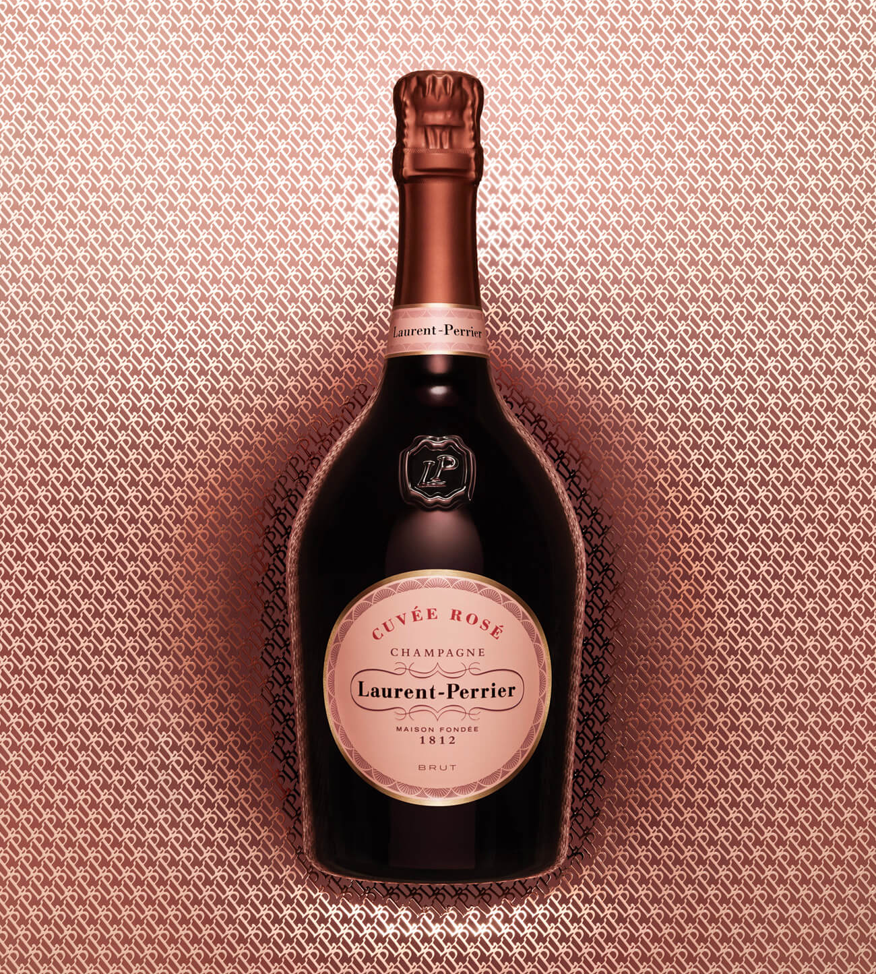
Laurent-Perrier Cuvée Rose
Grape varietal – 100% Pinot Noir
Region – Champagne. Mostly north and south Reims.
Vintage – Nonvintage. Minimum ageing is 5 years before release.
Aroma – Raspberry, red currant, strawberry and black cherry.
Taste – Bright and lively. Like plunging into a basket of fresh picked red berries.
Finish – Supple, rounded yet with nice acidity to make you go back again.
Price on menu - $38/BTG and $190/BTL
Pairings – Raw fish, Asian cuisine, red fruit desserts.
Additional info – Made using Saignee method, macerated for 48-72 hours to draw the color out of the skins.

Slide 4
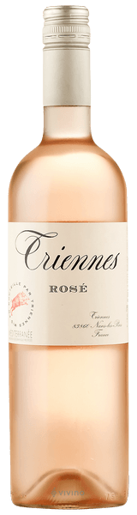
TRIENNES MEDITERRANEE, PROVENCE, FRANCE
Grape Varietal: Cinsault (Predominate), Grenache, Syrah, Merlot
Region: Provence, Mediterranee IGP, France Vintage: 2018 Aged: Wine is pressed after a few hours of skin contact. Aged in stainless steel tanks for 1 week.
Aroma: Strawberries, white flowers, hints of vanilla. Taste: Fresh red berry fruit, citrus, crisp acidity and elegance. Finish: Vibrant, Dry, and refreshing. Price on Menu: $15 Possible Pairings: Additional Notes: Wine owners of Domaine Dujac & Domaine de la Romanee-Conti are partners behind this project. Wine is Sustainable, Organic, & Biodynamic. Grapes are harvested at night.

Slide 5
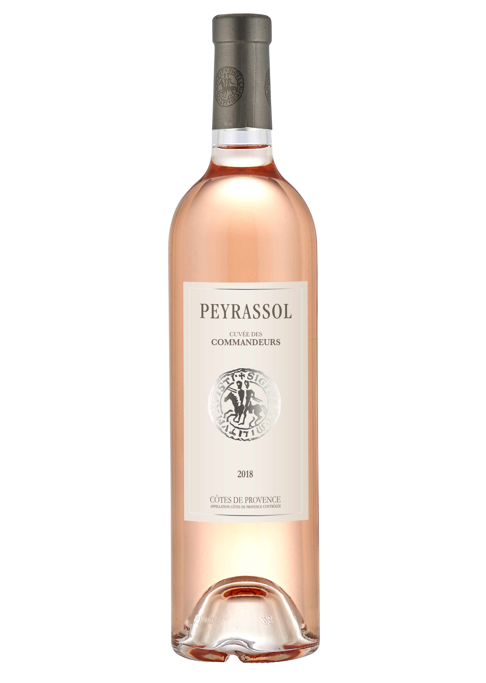
Peyrassol Cuvée des Commandeurs Rosé
Grape Varietal – Cinsault, Syrah and Grenache
Region – Cotes de Provence
Vintage – 2020
Aroma – Gooseberries and raspberries
Taste – Berries, melon, stonefruit.
Finish – Crisp, silky palate touch of minerality.
Price on menu – $18/BTG and $90/BTL
Pairings – Tuna Tartare, Tataki, seafood tower, whole branzino, berry desserts
Additional info – Records going back to 1256, about planting and harvesting grapes on the property.

Slide 6
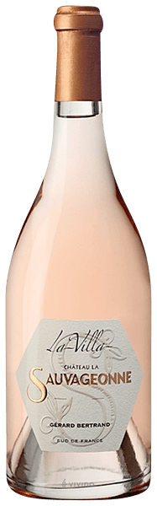
Gerard Bertrand Chateau La Sauvageonne, La Villa
Grape Varietals: Grenache, Mouvedre, Vermentino, and Viognier.
Region: Languedoc-Roussillon, France Vintage: 2019 Aged: Matured for 6 months in new French Oak barrels, bringing smoothness and structure.
Aroma: Watermelon, kiwi, nectarine, honeysuckle, mineral-driven.
Taste: Raspberry, grilled peach, apple pie, watermelon, red fruit, white pepper. Finish: Long, dry, medium acidity, creamy mouth feel.
Price on Menu: $25 BTG . $140 BTL Possible Pairings: Raw bar, Tuna, Maki, Rolls Additional Notes: 2019 vintage received the highest score at the Drinks Business Global Rose Masters 2020. Biodynamic practices.

Slide 7
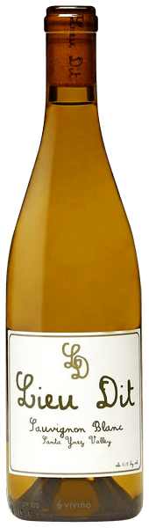
Lieu Dit, Sauvignon Blanc
Grape Varietal: Sauvignon Blanc Region: Santa Ynez Valley, California Vintage: 2017 Aged: Fermented in steel and barrel followed by aging in neutral oak.
Aroma: Citrus, melon, grapefruit, lemon-grass, white flowers.
Taste: Zesty, citrus rind, chalk, pear skin, lime, apricot, and white flower. Finish: Dry, high acid, bright, and citrus forward. Price on Menu: $16 BTG / $100 BTL Possible Pairings: Salads, Vegetables, light seafood Additional Notes: Varying soils of sand, shale, and gravel, and heavier clays. The vineyard the grapes are sourced from come from the eastern edge of the Santa Ynez Valley: Happy Canyon.

Slide 8
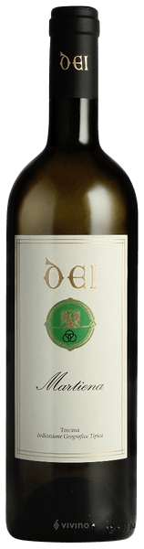
Dei ’Martiena’ White Blend IGT
Grape Varietal: 40% Chardonnay, 30% Malvasia Toscana, 20% Grechetto, 10% Sauvignon Blanc Region: Tuscany, Italy Vintage: 2019
Aged: Matured in stainless steel tanks for 5-6 months. Aroma: Soft scents of apple, yellow plum and wild flowers. Taste: Honeydew, pear, white peach, honeysuckle, lemon, orange.
Finish: Gentle fruit, bright acidity, and subtle minerality. Price on Menu: $16 BTG / $80 BTL Possible Pairings: Light seafoods, Salads Additional Notes: Winery adheres to precise organic standards. This wine is considered Vino Nobile di Montepulciano.

Slide 9
Domaine De La Rossignole Sancerre
Grape Varietal – 100% Sauvignon Blanc
Region - Loire Valley, France
Vintage - 2020
Aroma – Floral and spicy
Taste – Citrus, lemon and minerality
Finish – Crisp and clean
Price on menu
Pairings – White meats, fish dishes and spicy preperations
Additional info – Making wines since 1848 on the same land.

Slide 10
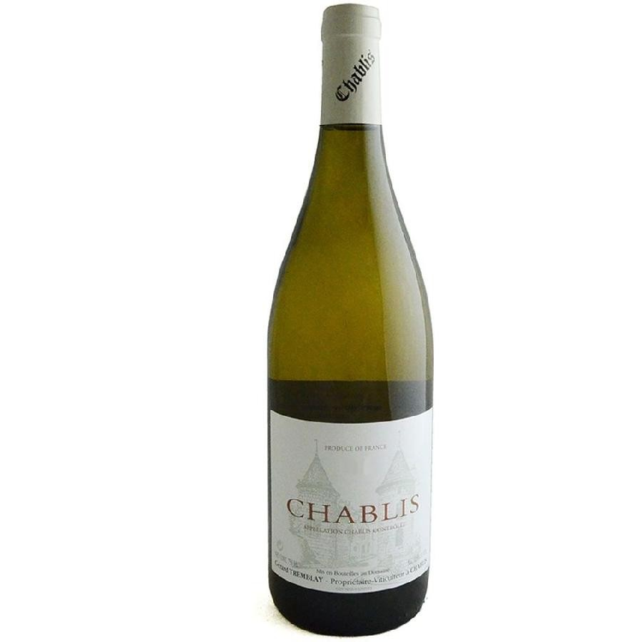
Gerard Tremblay Chablis
Grape Varietal – 100% Chardonnay
Region – Chablis, France. North Burgundy
Vintage - 2019
Aroma – red and green apples, oyster shell, white flowers
Taste – Fresh and crisp with notes of lime and lemon.
Finish – Dazzling acidity brings the lemon notes out and makes you want to keep drinking
Price on menu - $20/BTG and $100/BTL
Pairing – Oysters and shellfish, rich fish, hard cheeses, pastas, white meats
Additional info – Vines are 20-30 years old.

Slide 11
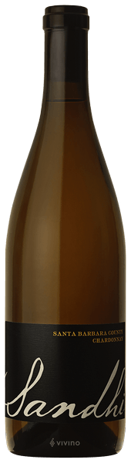
Sandhi, Central Coast, Chardonnay
Grape Varietal: Chardonnay Region: Santa Barbara (Santa Rita Hills), California Vintage: 2016 Aged: 10 months in barrel and finally racked to stainless steel tanks. Fermented in Older French Oak barrels. Aroma: Lemon, apple, pears, lime peel, Taste: Butter, vanilla, creamy and buttery with spiced, lemon, apple, quince, guava. Finish: Rich, round, medium acidity. Price on Menu: $20 BTG / $100 BTL Possible Pairings: Branzino, Seabass, Chicken Additional Notes: Does not use herbicides or chemical fertilizers.

Slide 12
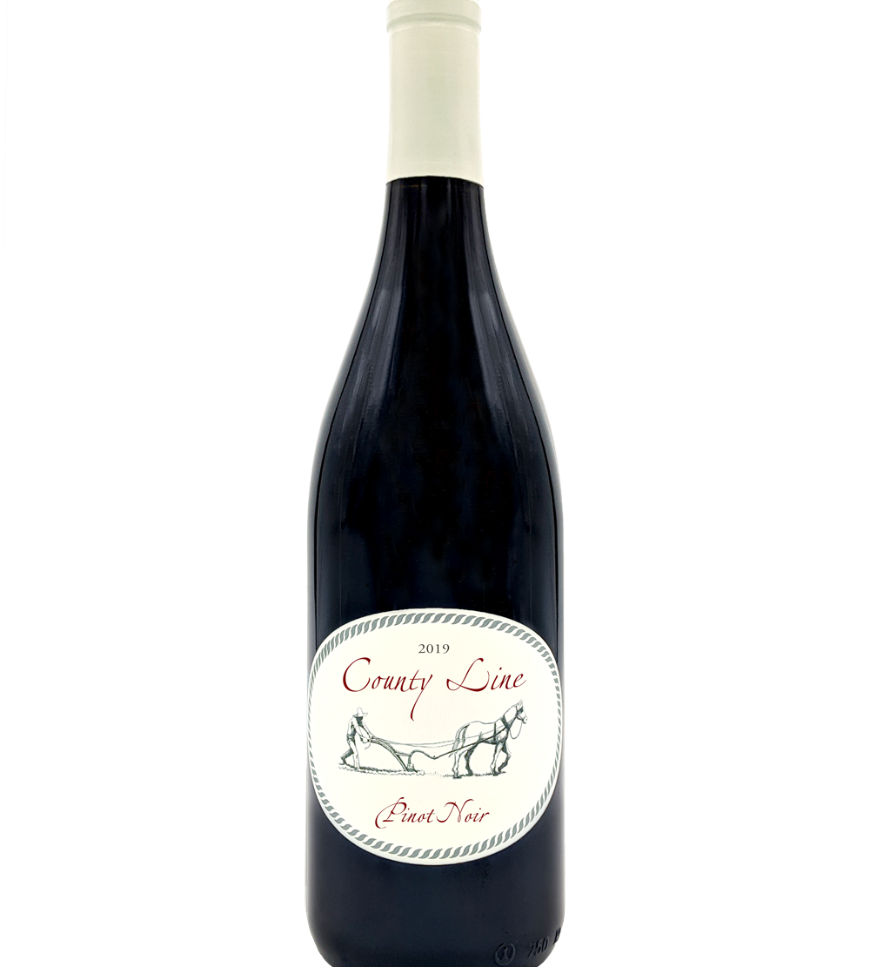
County Line Pinot Noir
Grape Varietal – 100% Pinot Noir
Region – Sonoma Coast, CA
Vintage - 2019
Aroma – Dried strawberries, Raspberries, Bing Cherry
Taste – Red fruits, Forest floor, Bergamot tea, rose petals
Finish – Balanced acidity and easy tannins that linger
Price on menu - $25/BTG and $125/BTL
Pairings – Mushroom dishes, Tuna steak
Additional info – Organically farmed, neutral French oak, unfiltered

Slide 13
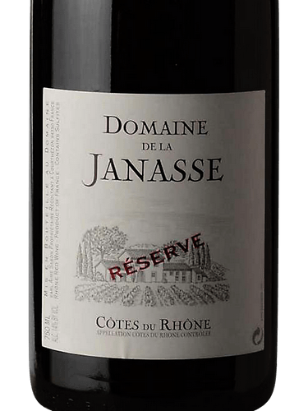
Domaine de la Janasse Cotes du Rhone Reserve
Grape Varietals – 55% Grenache, 25% Syrah, 10% Carignan, 5% Cinsault, 5% Mourvedre
Region – Cotes du Rhone, Rhone Valley, France
Aroma – Herbs de Provence, Strawberry, Blackberry, Licorice
Taste – Raspberry, Cherry, Earthy, Grilled Plum
Finish – Medium Long
Price on menu - $18 BTG / $95 BTL
Pairings – Grilled Meats
Additonal Info – Comes from a 20 acre plot next to the Chateauneuf du Pape vineyards. No pesticides or insecticides were used in the vineyards. Hand harvested.

Slide 14
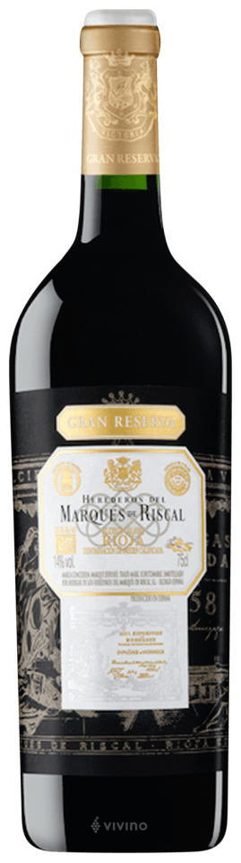
Marques de Riscal Rioja, Gran Reserva
Grape Varietal: 90% Tempranillo, 10% Graciano
Region: Rioja, Spain Vintage: 2012 Aged: 2 years in American Oak barrels.
Aroma: Dried berry, chocolate, spice, and earthy. Taste: Plum, blackberry, dark berries, light toast, oak, tobacco, vanilla, leather, earthy, smoke. Finish: Structured and powerful. Long with slight reminder of fine oak. Price on Menu: $25 Pairings: Beef, Game, Additional info: This was the first winery in the Rioja to produce wines following the Bordeaux method. Planted in the best clay- limestone soils of Rioja.

Slide 15
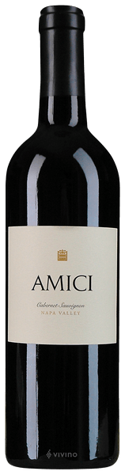
Amici Cellars Cabernet Sauvignon
Grape Varietal: Cabernet Sauvignon Region: Napa Valley, California Vintage: 2018 Aged: Aged 22 months in 100% new French Oak barrels.
Aroma: Blackberry, black currant, and blueberry, cedar. Taste: Fruit-forward, black raspberry, black plum, and blackberry cobbler, with spice, savory herbs, vanilla, and hazelnut.
Finish: Drying tannins linger on the medium-long finish.
Price on Menu: $30 BTG / $150 BTL Possible Pairings: Tomahawk, Wagyu Additional Notes: 2020 Winemaker of the year, Anthony Biagi.

Slide 16
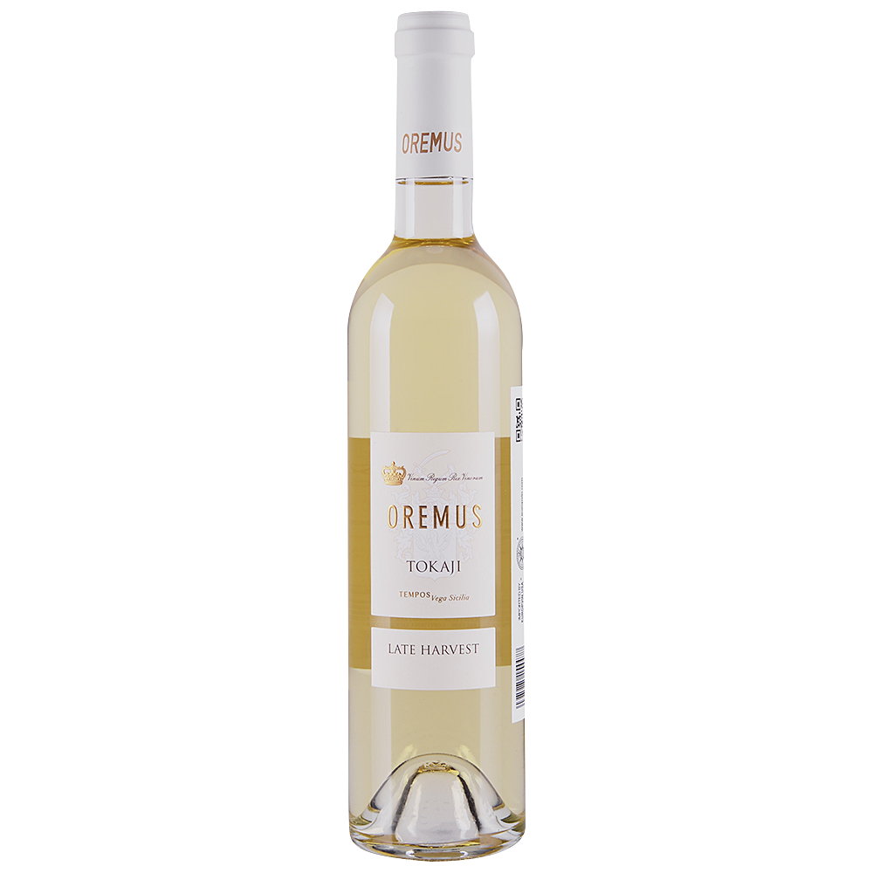
Oremus, Tokaji, Hungary
Grape Varietal: Furmint, Hárslevelü, Zéta and Sárgamuskotály
Region: Tokaj, Hungary
Vintage: 2018
Aroma: Stonefruits, honey, citrus
Taste: Apricot, peach, ginger, honey, citrus
Finish: Long smooth, nice little acidity to cleanse the palate and make you want more
Price on Menu: $16
Pairings: Japanese cheesecake, olive oil cake
Additional info: Part of Bodega Vega Sicilia. Minimum 50% of grapes affected by Noble Rot, Botrytis Cinerera. Vineyard dates to 1630.

Slide 17
Taylor Fladgate, 20 Year Tawny Porto
Grape Varietal: Touriga Nacional, Touriga Franca, Tinta Barroca, Tinta Roriz, Tinto Cão, and Tinta Amarela
Region: Duoro, Portugal
Vintage: MV
Aroma: Wood, walnut, spices
Taste: Dried apricot, leather, spices
Finish: Multiple level finish with complexity.
Price on menu: $20
Pairings: Cheeses, sweet desserts
Additional info: Over 300 years old. Last family run British port business. 111g/L of sugar.

